Slide 1

Restaurant Android Application
Group 4

Slide 2
Abstract
We have developed an online client/server food ordering application for a restaurant. Assumption has been made that the restaurant is using internet to run its business. The customers can order food online and pick it up when the food is ready.
In our application, we are passing information wrapped in messages between client and server. The chef and customer can log in one application with their credentials and are taken to their respective work areas. The chef can view the oldest order, change the status of order and view the next order once the oldest order is ready.
We’re managing Inventory using the Inventory.txt file

Slide 3
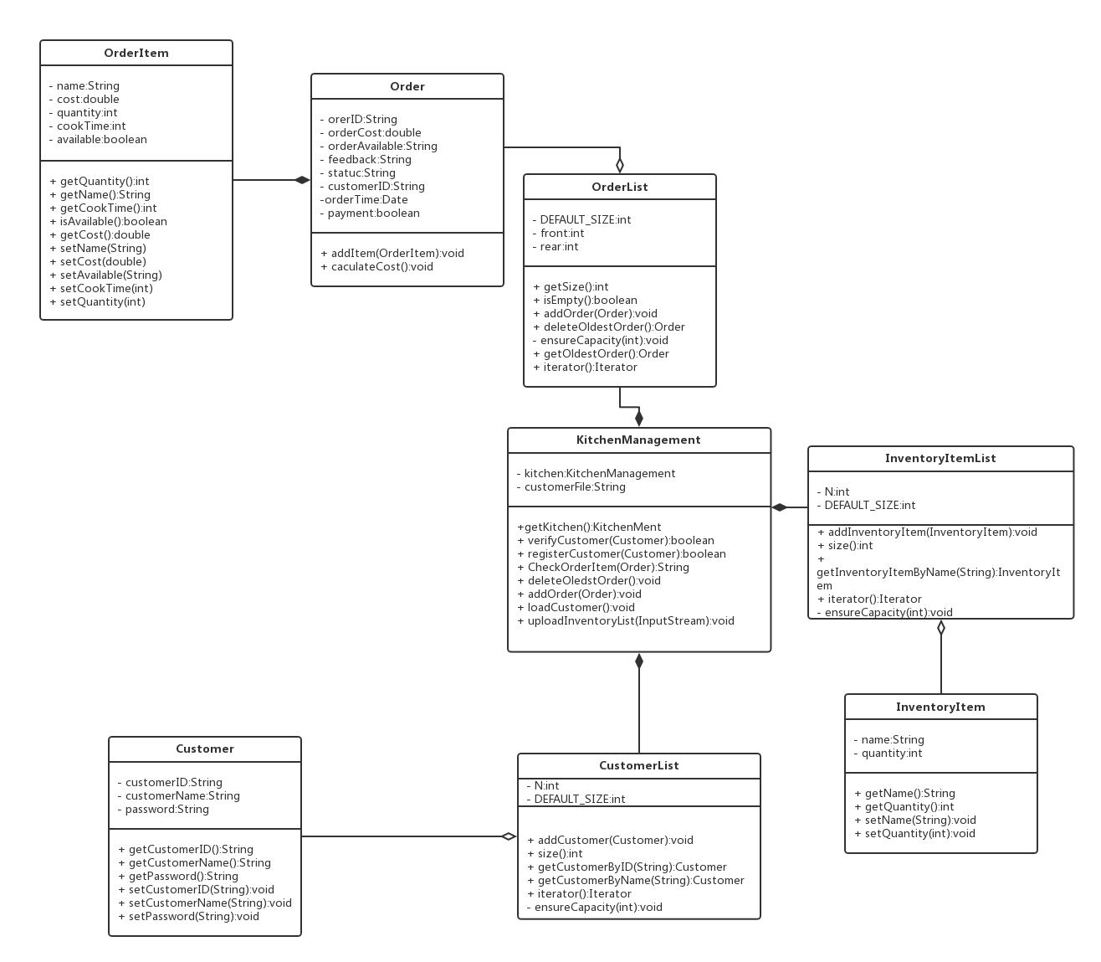
Class diagram

Slide 4
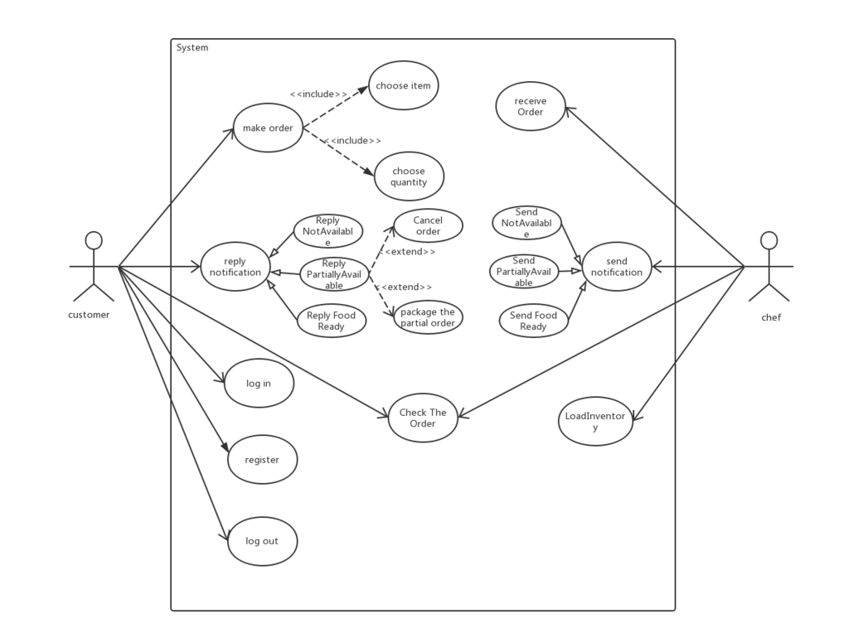
Use-case diagram

Slide 5
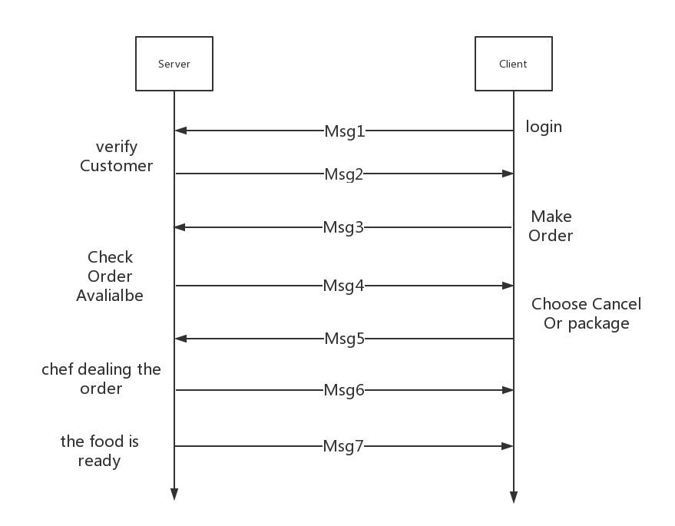
Message passing between Client/Server

Slide 6
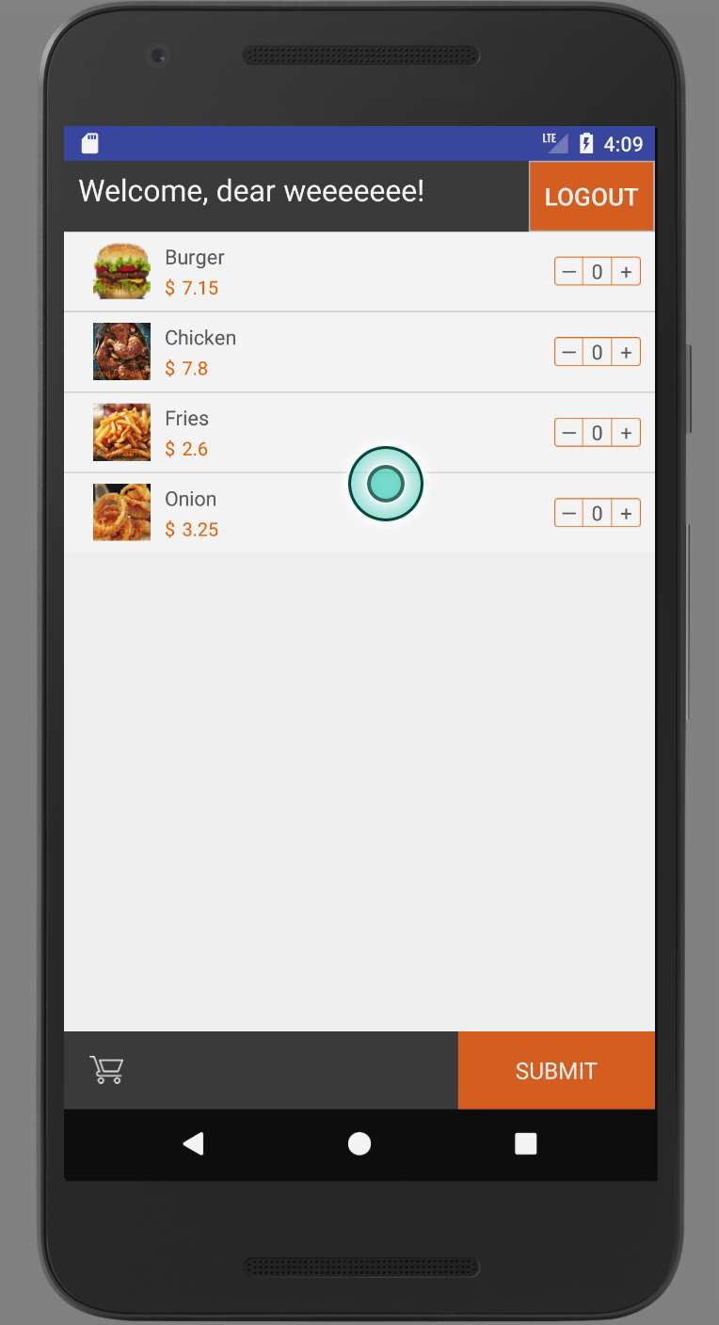
Msg1 : “R/S,customerID,customerPIN,customerName(exists when register)”
e.g.:”R,CU1234,2333,Kiven” “S,CH1234,3333”
Msg2: “R/S,customerName,success/fail”
e.g.: “R,Kiven,success” “S,Bob,fail”
Msg3: “orderID,orderCost,customerID,MM/DD/YYYY,[ItemName],[ItemQuantity]…”
e.g.: “123,30000,CU1234,10/02/2222”
Msg4: “AA(allavailable)/PA(partiallyavailable),[ItemName],[ItemQuantity]/NA(notavailable),time”
“PA, ”: “PA,[Orderitemname]”;
e.g.: “AA” “PA” “NA”;
Msg5: “T/F”
e.g.: “T” “F”
Msg6: “Packaging”
Msg7: “FoodReady”

Slide 7
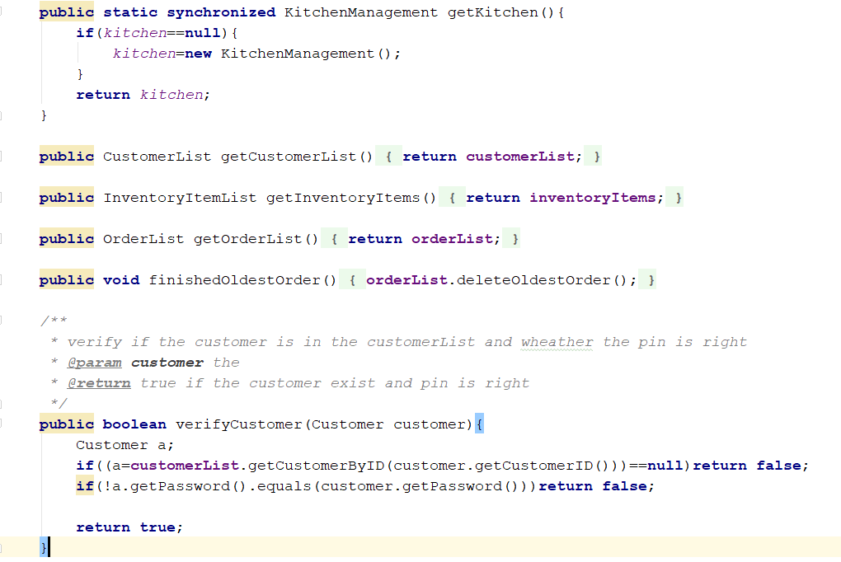
Design Patterns considered
Singleton Pattern
class Kitchen Management:

Slide 8
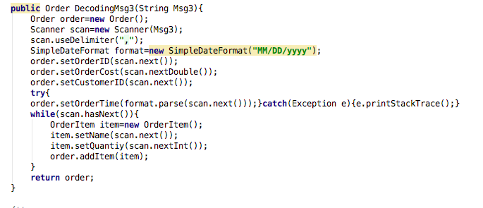
Multiple Threads
Encoding and Decoding of messages :

Slide 9
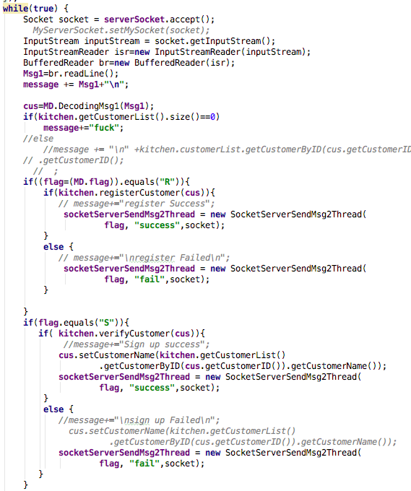
Multiple Threads
Socket Server Thread :

Slide 10
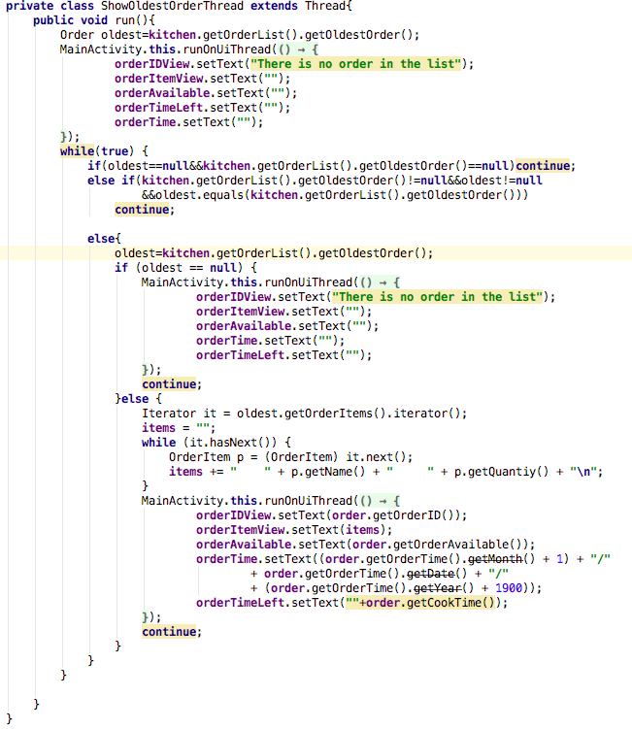
Multiple Threads
Show Oldest Order
Thread :

Slide 11
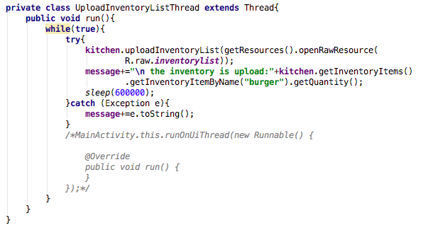
Multiple Threads
Upload Inventory List Thread :

Slide 12
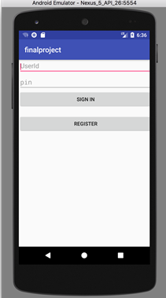
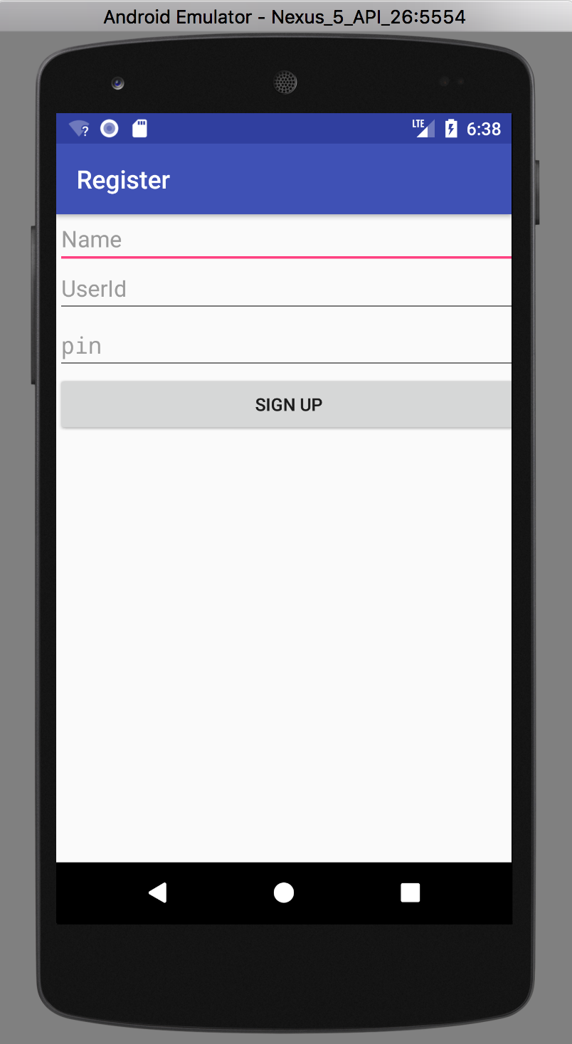
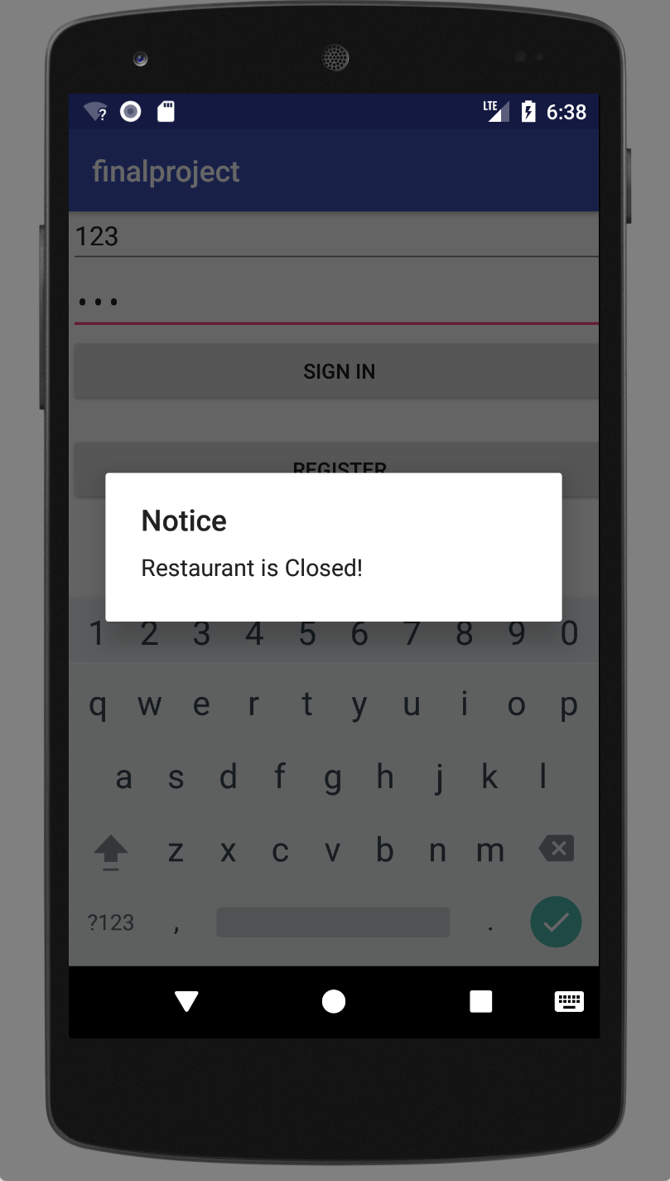
Client Side Components
Log In/ Register :

Slide 13
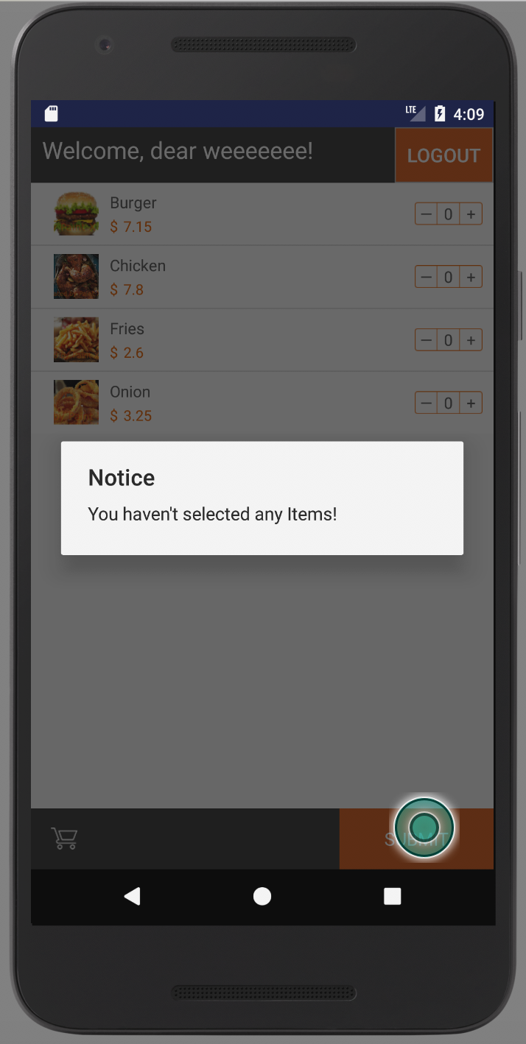
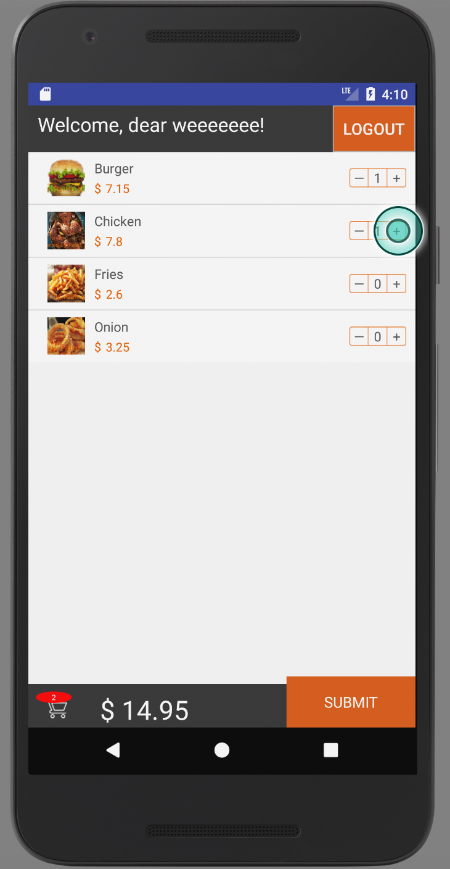
Client Side Components
Selecting your order :

Slide 14
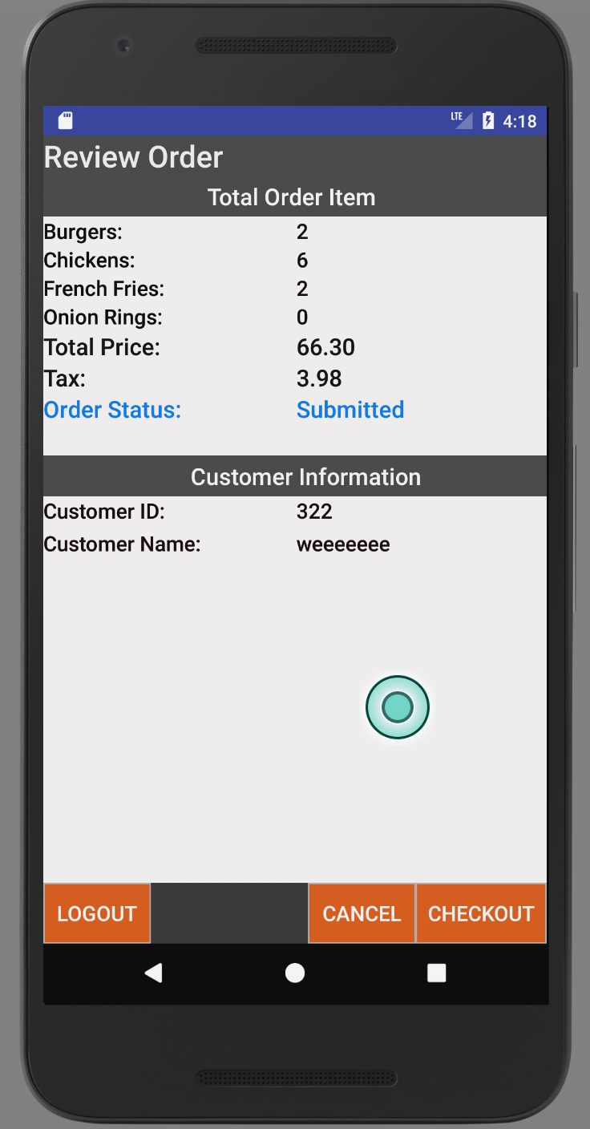
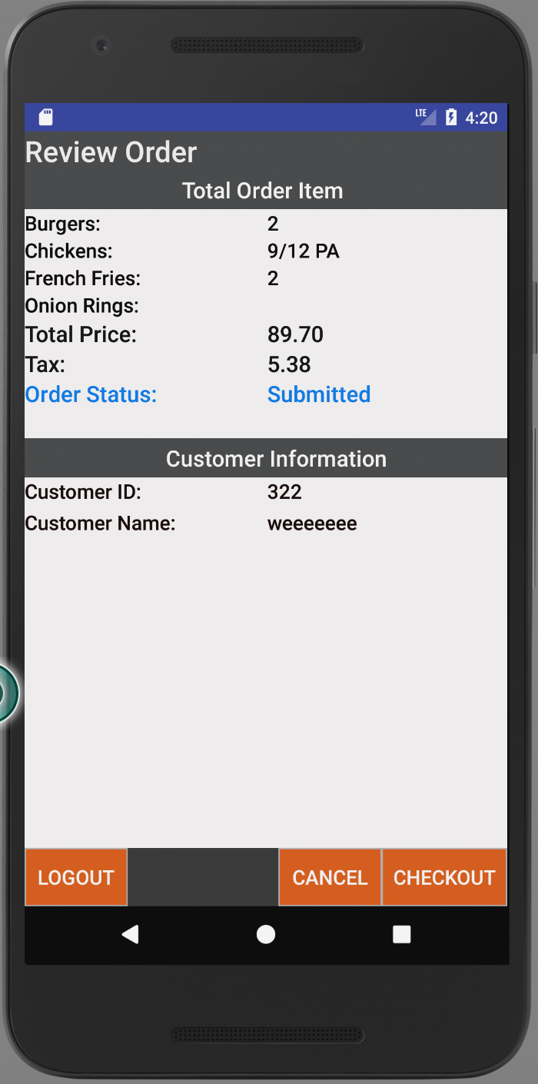
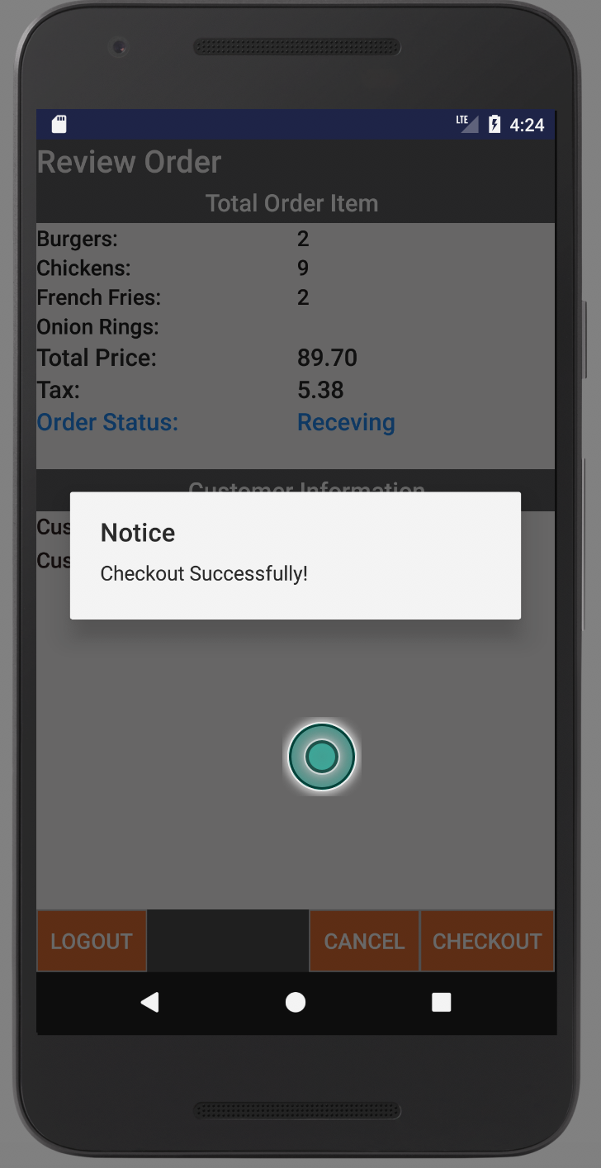
Client Side Components
Reviewing your order :

Slide 15
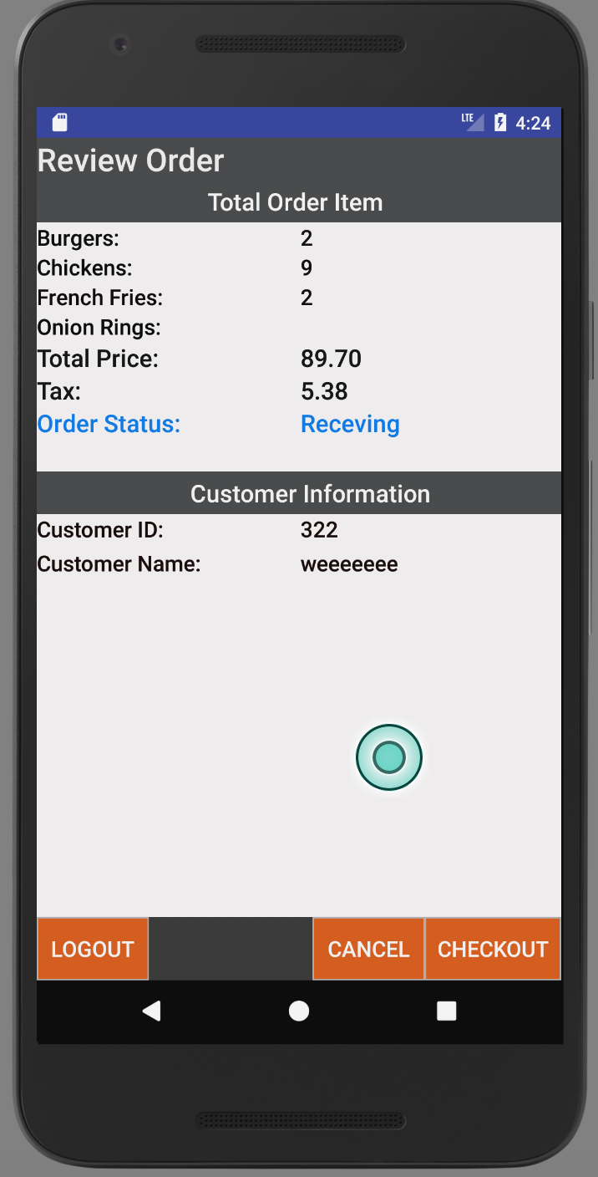
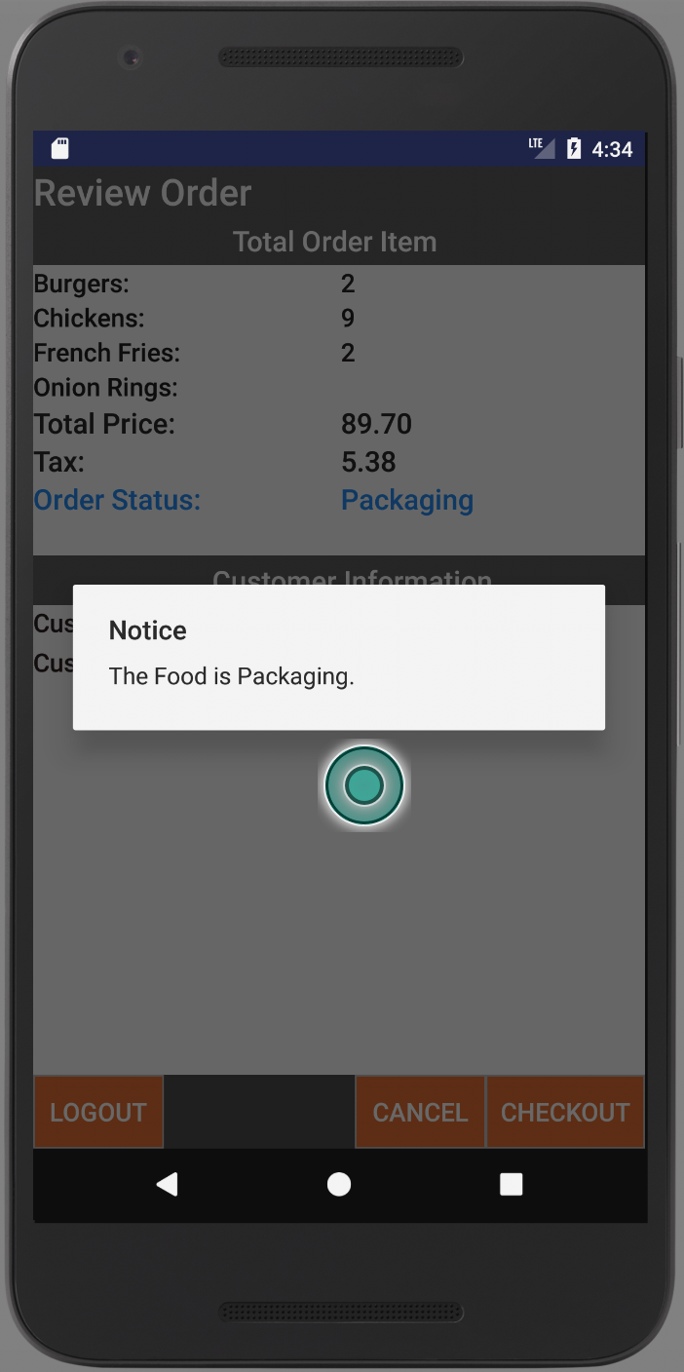
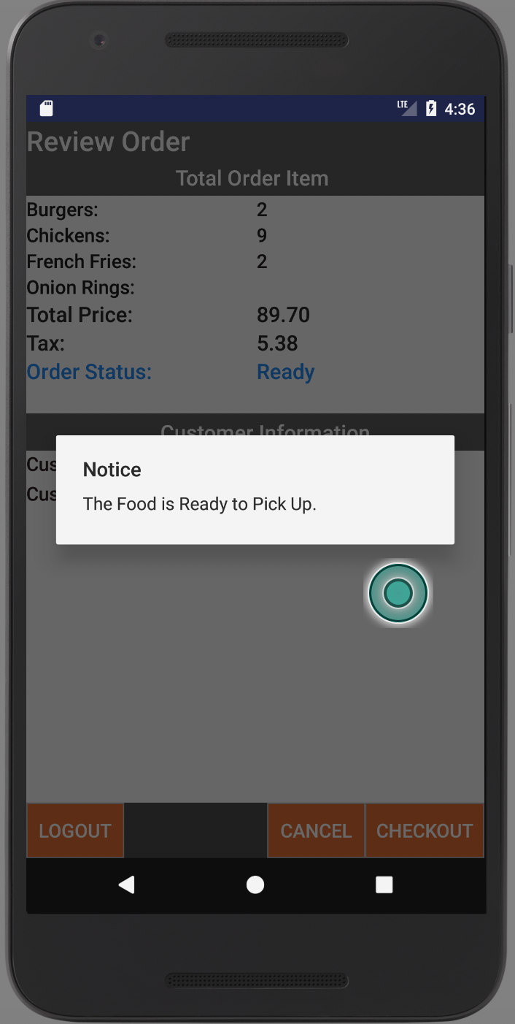
Client Side Components
Reviewing your order (continued) :

Slide 16
Server Side Components
We have a singleton class called kitchen management on the server side
Here, the inventory list, customer list and order list are initialized once.
Chef Activity is another class which takes care of the orders which are received from the client side.
It checks in the inventory list whether enough items are available to suffice the order.
We have a thread which is always running in the background which listens to the client side and checks if we have a new order in the order list.
Chef activity has two main functions –
One is uploading the inventory list and another is notifying the customer whether the order is available or not.

Slide 17
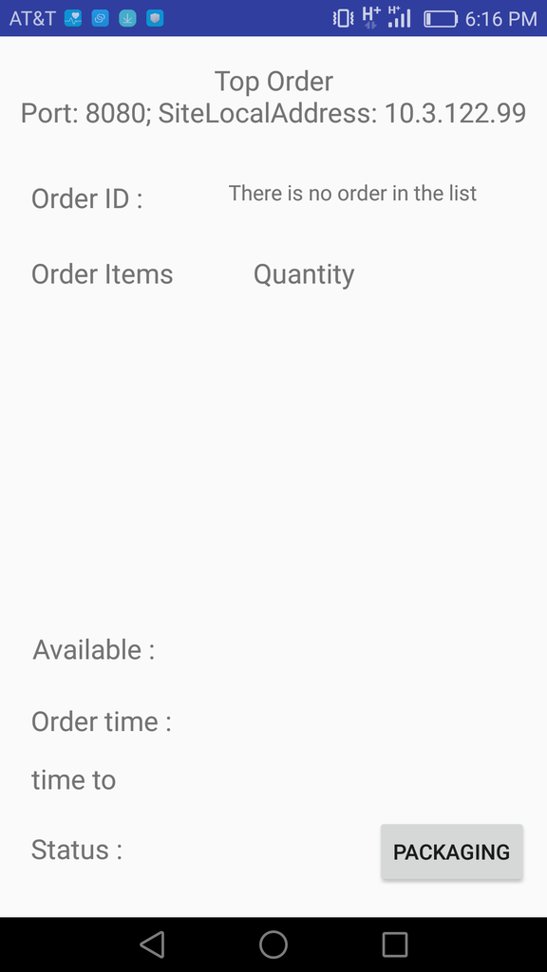
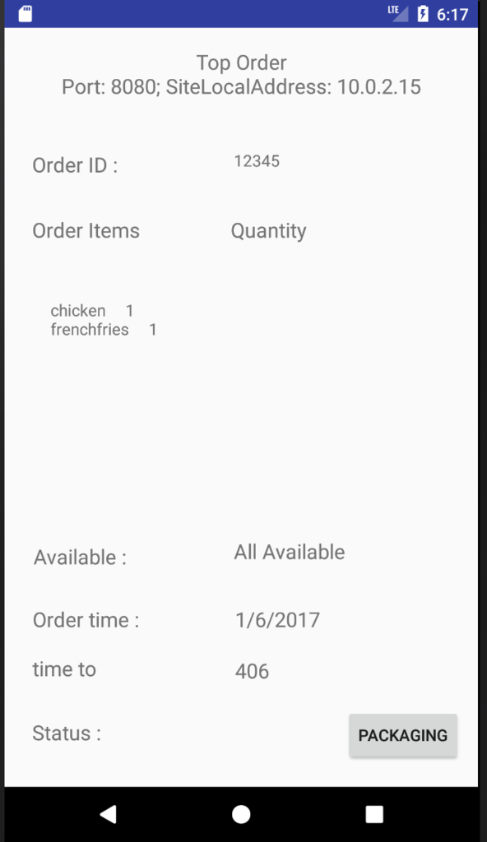
Server Side

Slide 18
Acknowledgement
I would like to acknowledge the participation of the team members Xiao, Yun, Kinnari, Myron and Apoorav. I would also like to acknowledge the support of the Professor Mohsen Ghassemi and Samira Mansouri.
Thank you very much.

